Slide 1
Continuous Deployment of a Python Flask Application with Docker and Jenkins.

Slide 2
Creation and implementation of continuous integration and delivery, using services such as:
Terrafom
Ansible
GitHub
Jenkins
Docker
AWS

Slide 3
Purpose
Terraform is excellent at managing cloud services for provisioning of infrastructure at scale, it is excellent for the initial server setup, primarily infrastructure while delegating configuration tasks to Ansible. Ansible is a lot easier to configure for software setup.
Jenkins and Docker are that widely used tools that help automate an IT Infrastructure efficiently. Using them together makes development, testing, and deployment much easier and much faster.

Slide 4
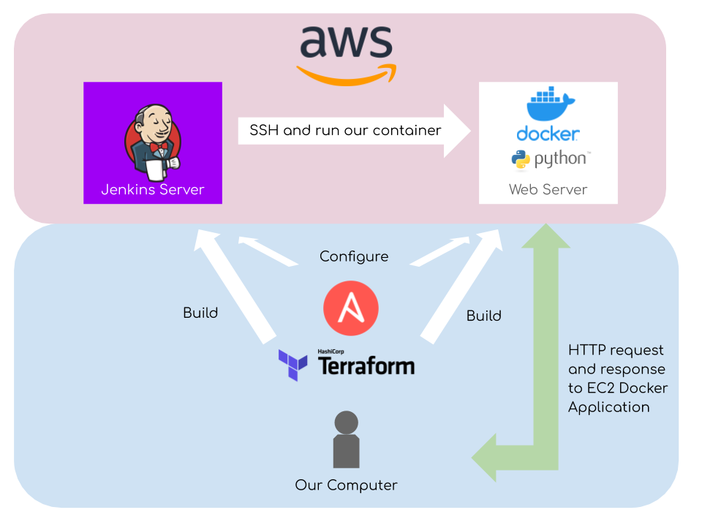

Slide 5
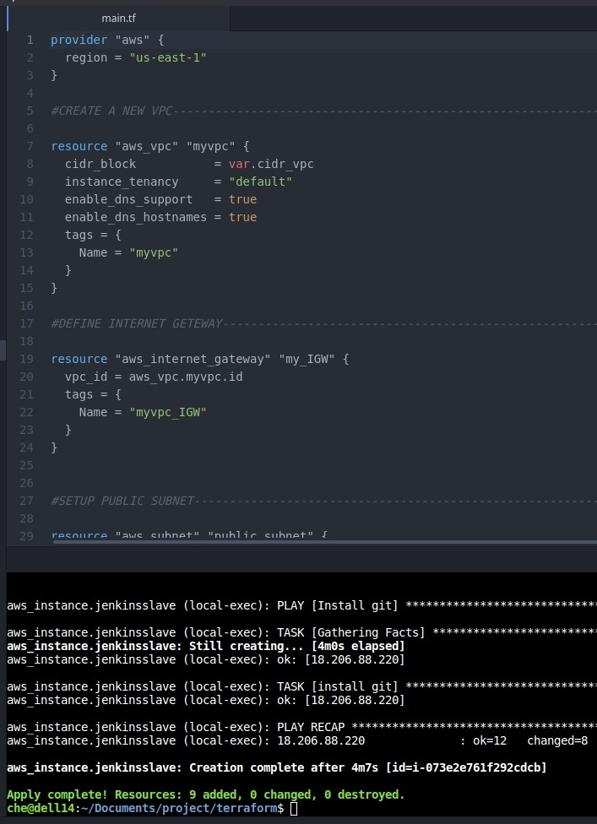
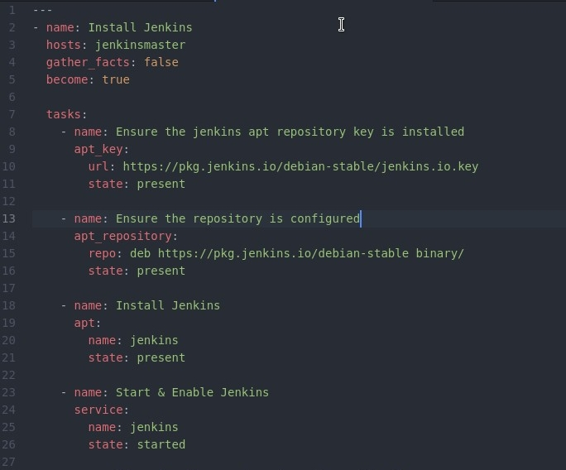
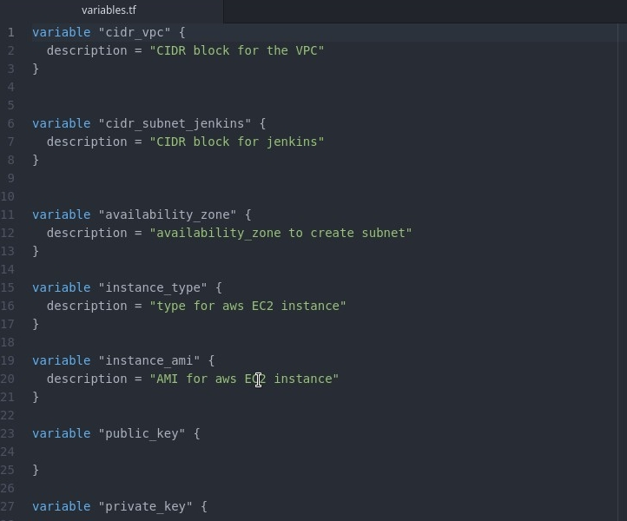
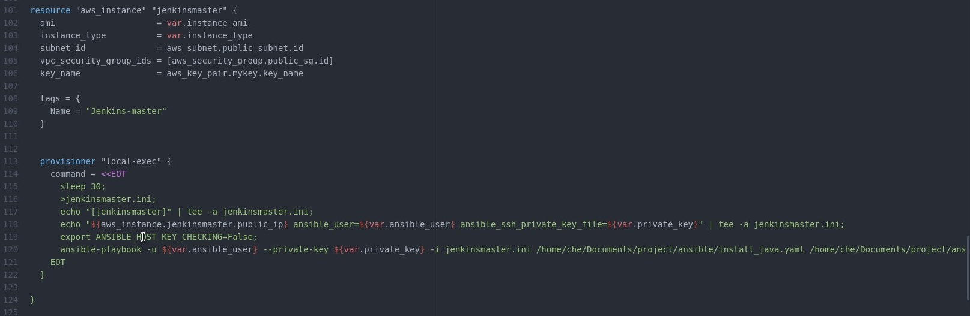
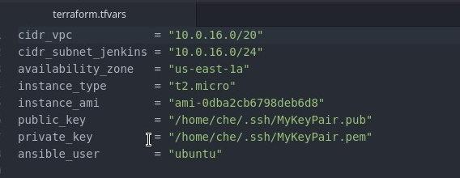
Terraform and Ansible

Slide 6
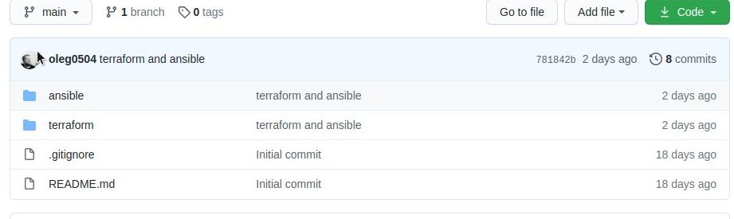
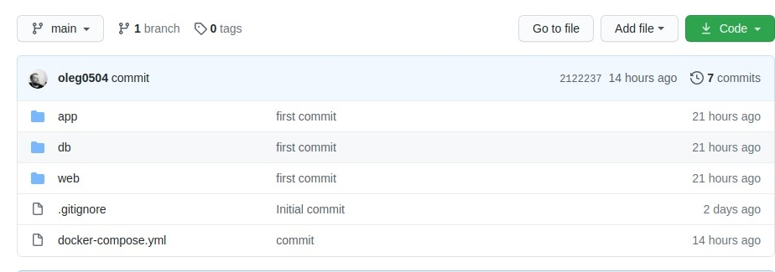
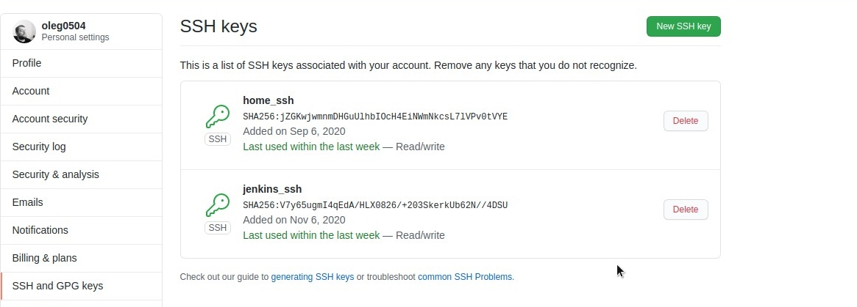
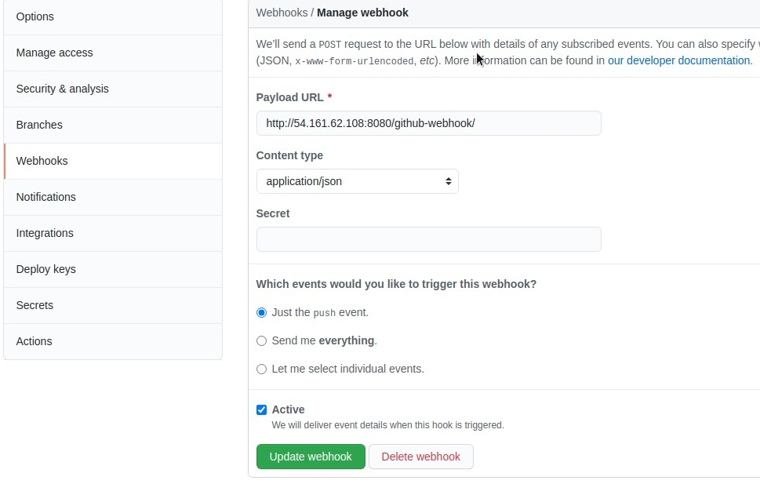
GitHub

Slide 7
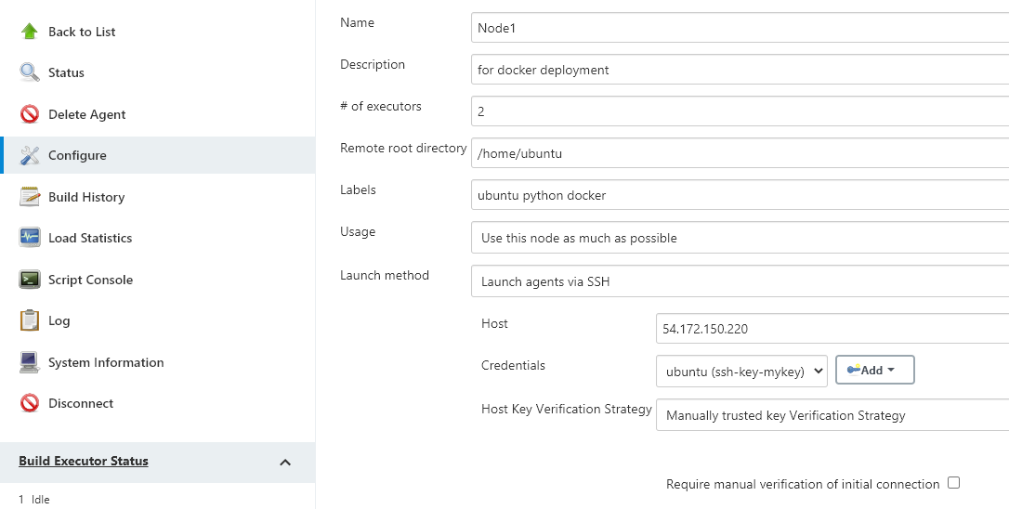
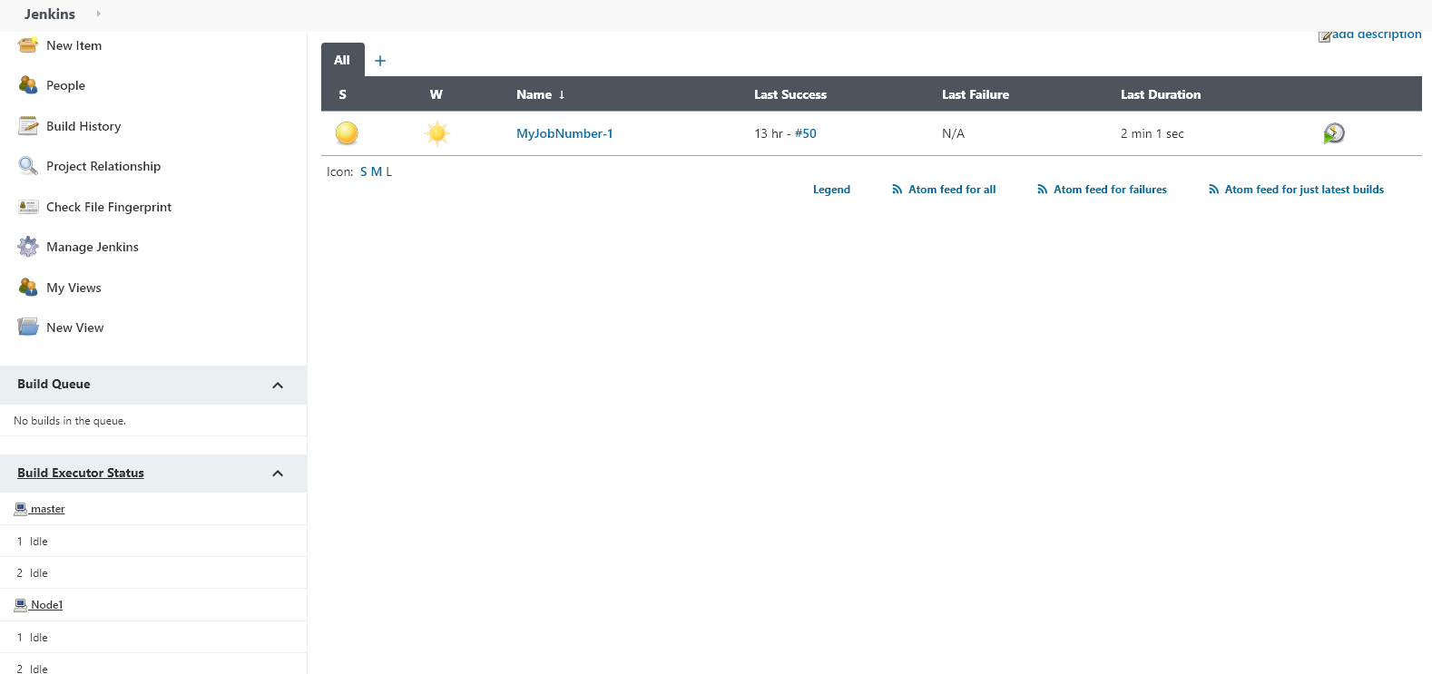
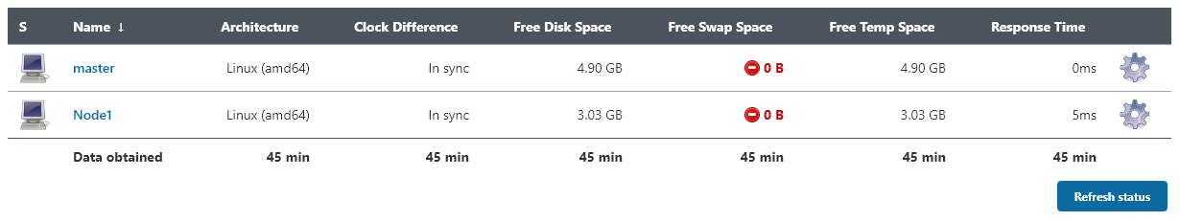
Jenkins

Slide 8
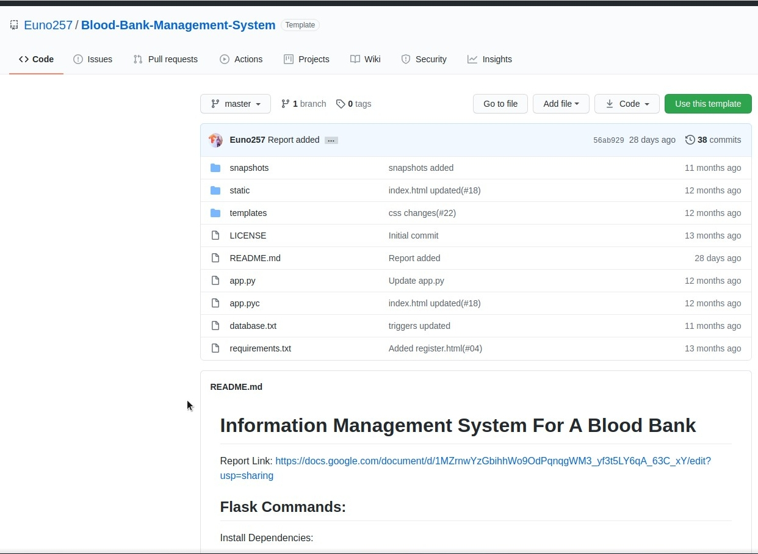
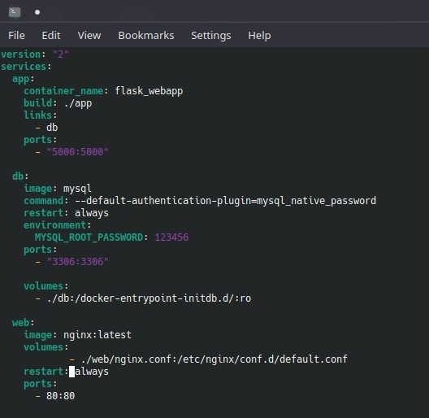
Docker

Slide 9
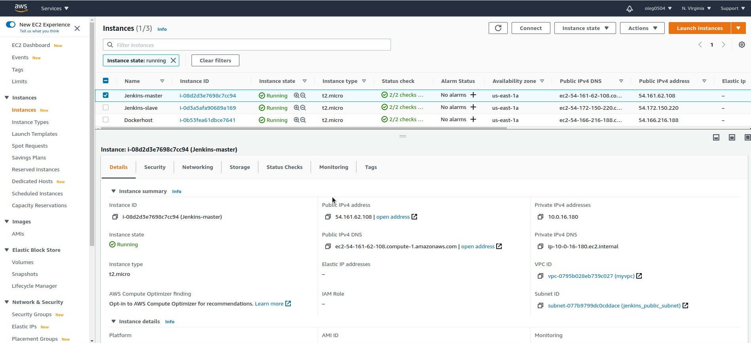
AWS

Slide 10
Links
https://stackoverflow.com
https://learn.hashicorp.com/tutorials/terraform/aws-build
https://github.com/Euno257/Blood-Bank-Management-System
https://ansible-tips-and-tricks.readthedocs.io

